Slide 1
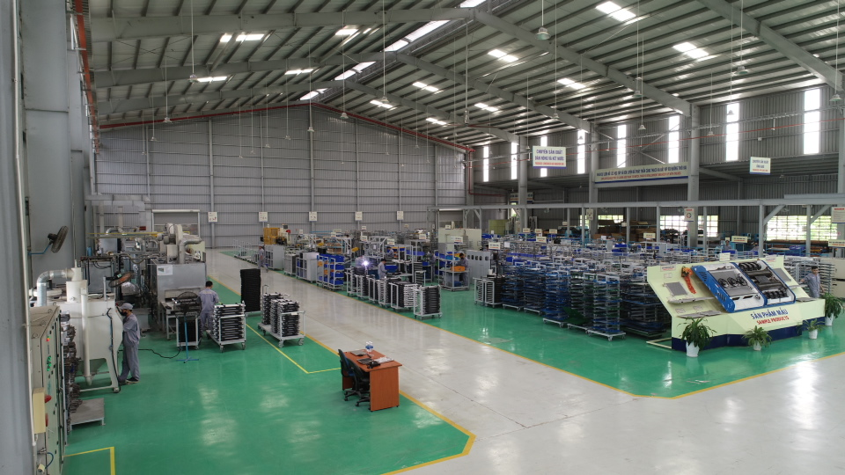

Slide 2
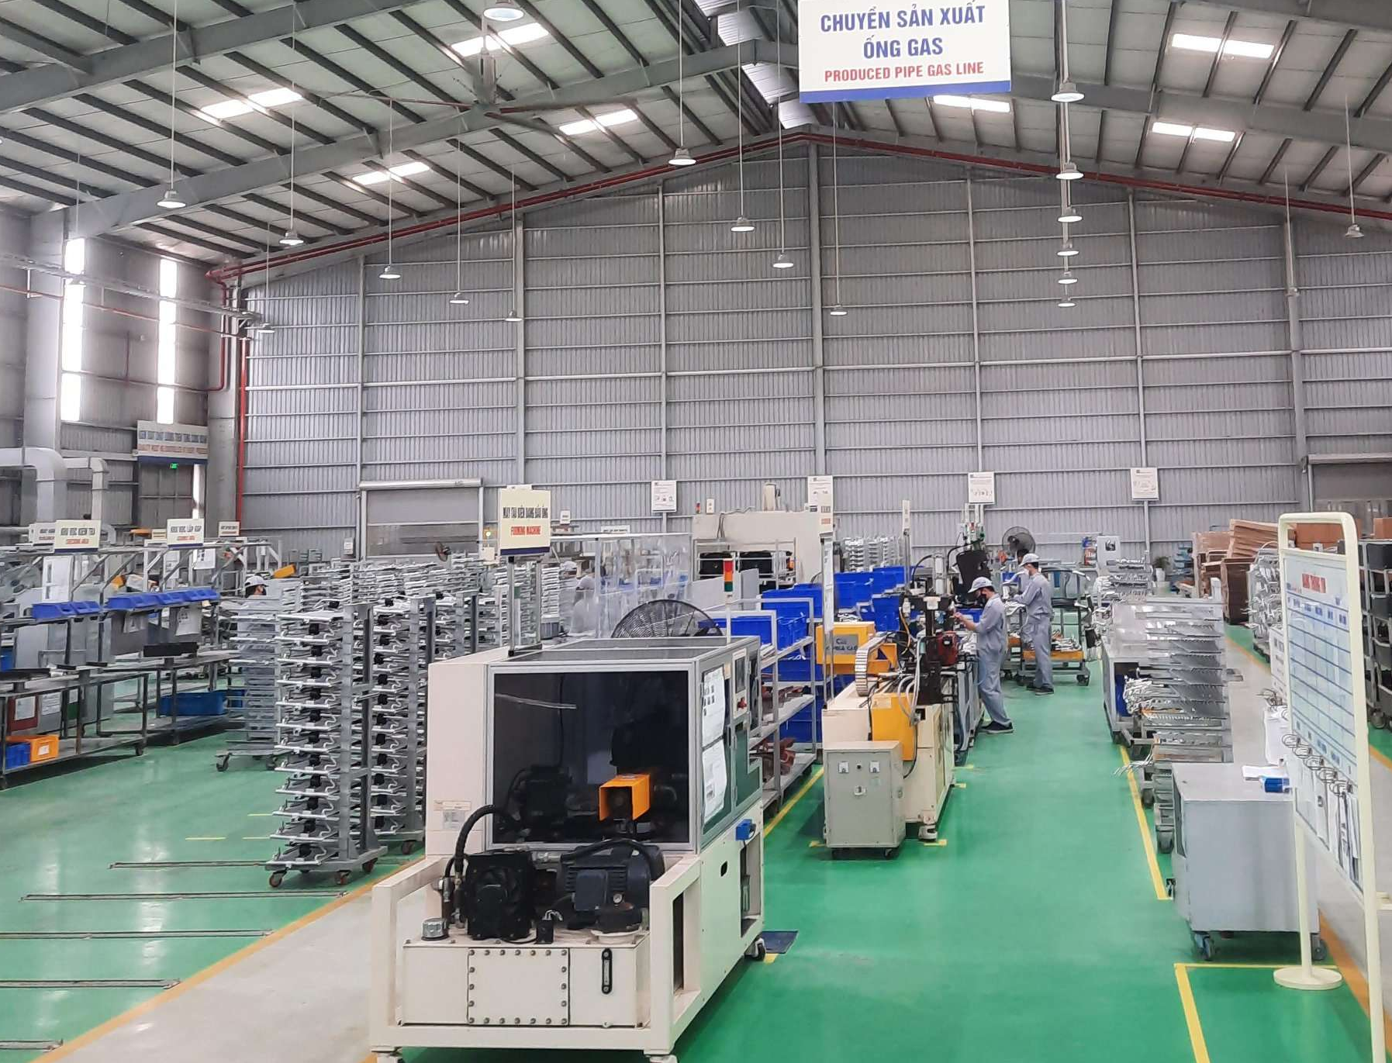

Slide 3
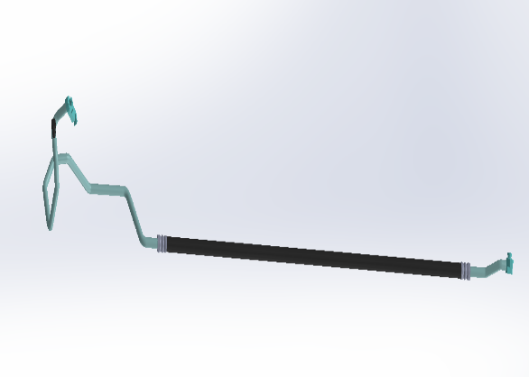
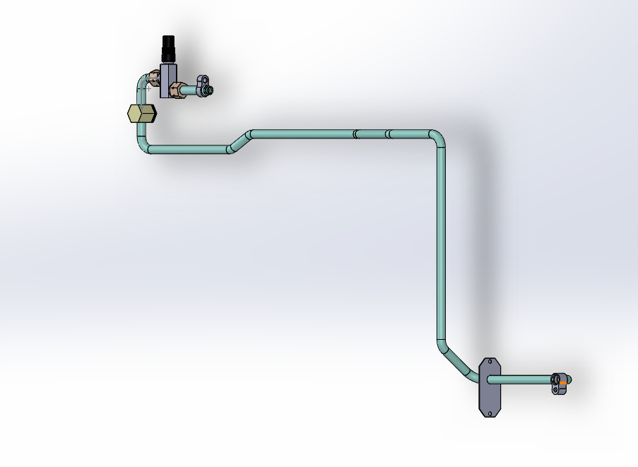
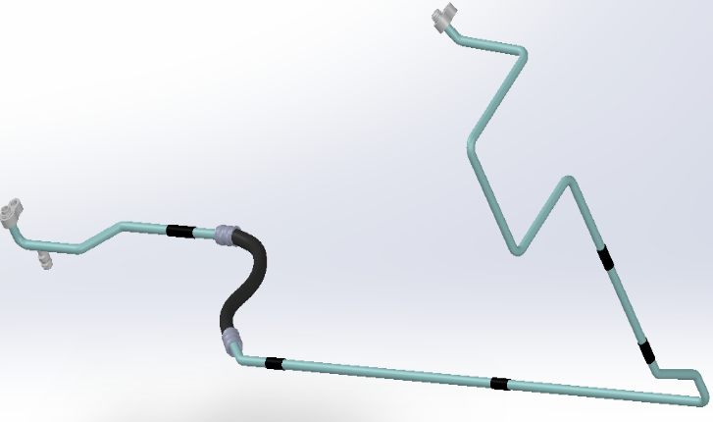
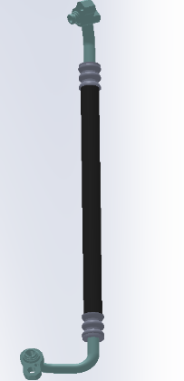
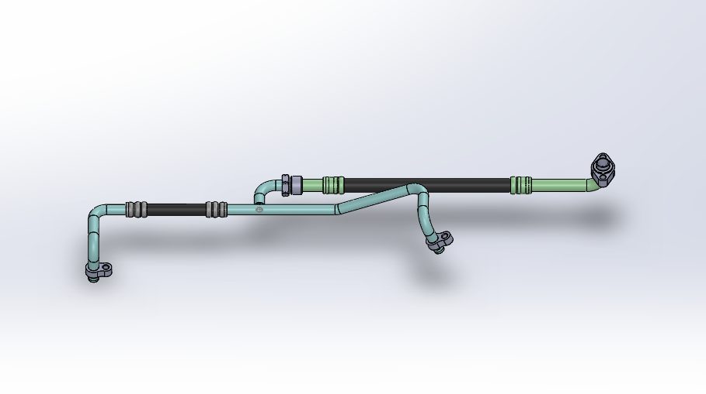
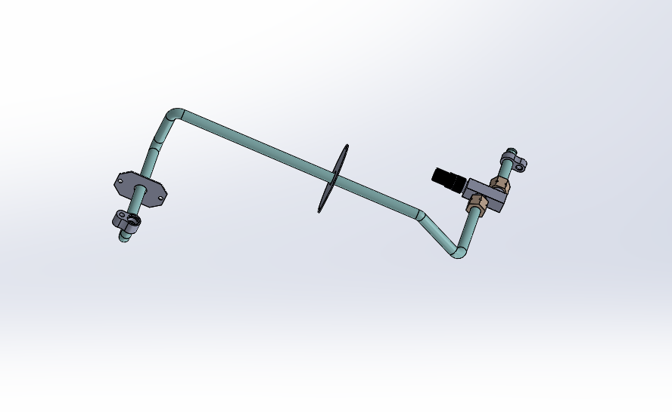
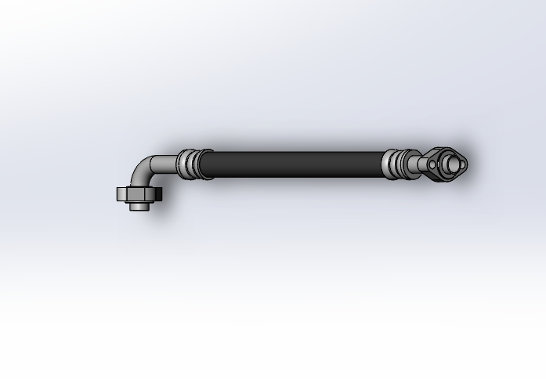
PRODUCTS
THACO TACC
HOSE & PIPE
Hose & pipe
Truck Kia Frontier K200/ K250
Hose & pipe
Bus Thaco Mobihome (TB120SL)
Hose & pipe
Truck Fuso Canter 4.99/ 6.5
Hose & pipe
Bus Thaco Garden (TB79S)
Hose & pipe
Bus Thaco Bluesky (TB120S)
Hose & pipe
Bus Thaco Meadow (TB85S)
Condenser of Hyundai ACCENT

Slide 4
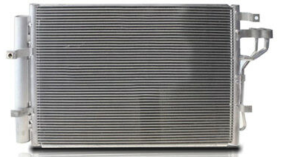
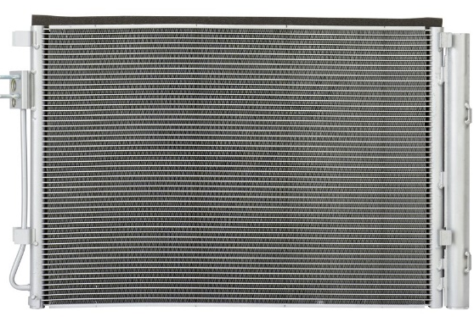
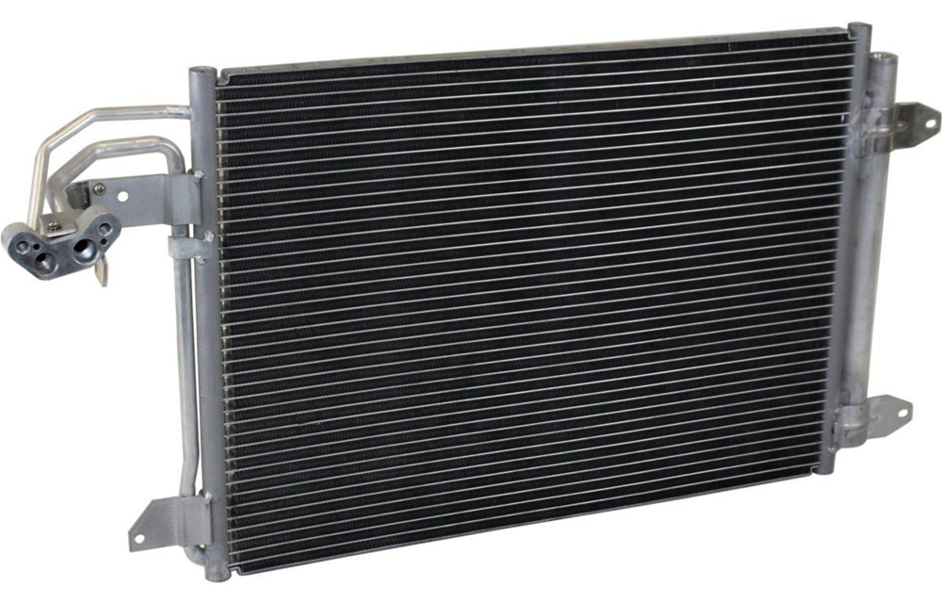


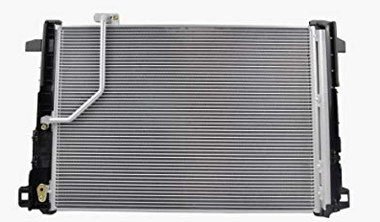
PRODUCTS
THACO TACC
CONDENSER FOR EXPORT
Condenser of Kia Morning
Condenser of Hyundai Grand i10
Condenser of Audi A3 II
Condenser of Peugeout 407
Condenser of Toyota Corolla
Condenser of Mercedes Benz
Condenser of Hyundai ACCENT

Slide 5

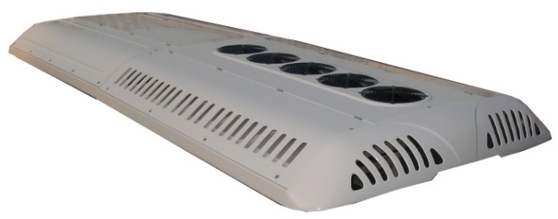
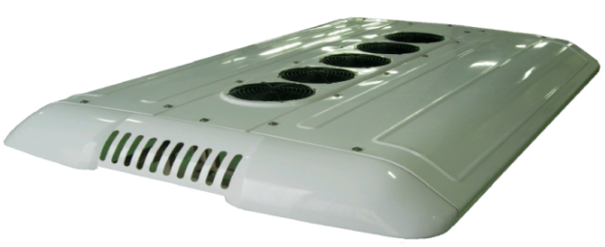
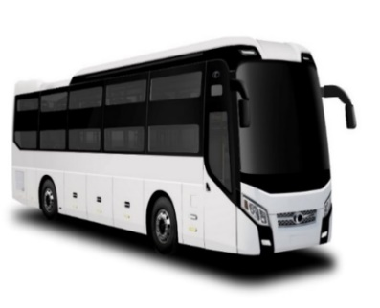
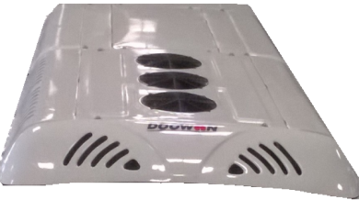
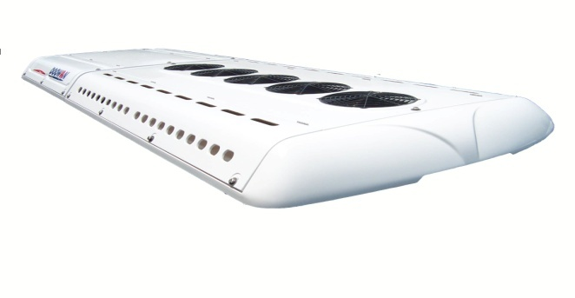
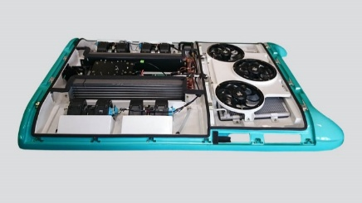
PRODUCTS
THACO TACC
THACO BUS AIR CONDITIONER
Air Conditioner DWS-300
Capacity: 30.000 Kcal/h
Air Conditioner DSI-280
Capacity: 28.000 Kcal/h
Air Conditioner DS-58
Capacity: 24.000 Kcal/h
Air Conditioner DS-38
Capacity: 20.000 Kcal/h
Air Conditioner DI-150
Capacity: 15.000 Kcal/h

Slide 6
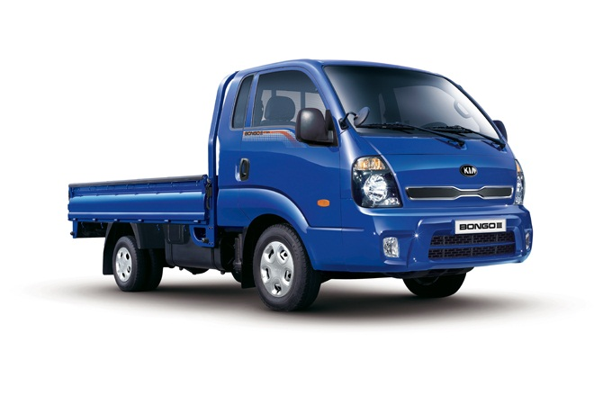
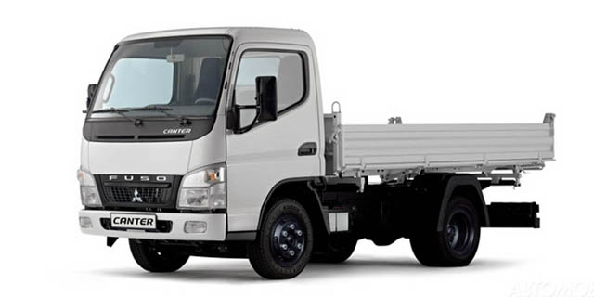
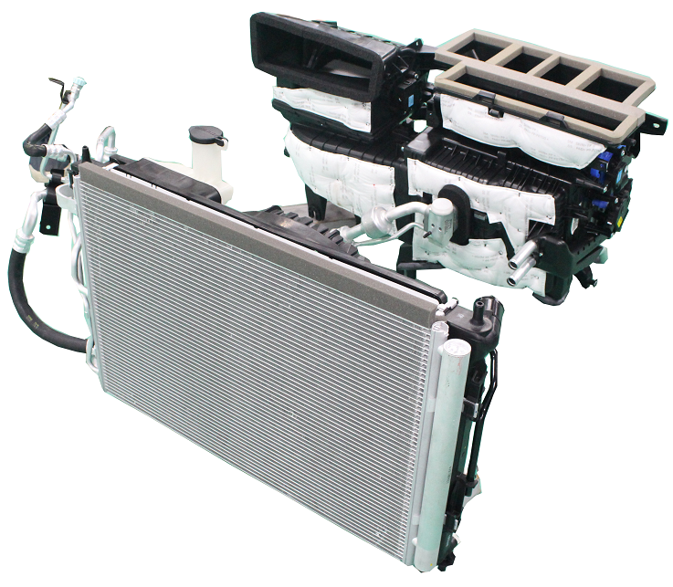
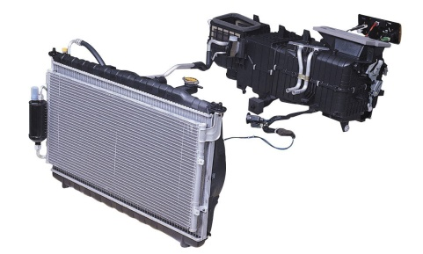
PRODUCTS
THACO TACC
TRUCK AIR CONDITIONER
KIA New Frontier air conditioner
(K200/ K250)
Fuso Canter air conditioner
(4.99/6.5)

Slide 7
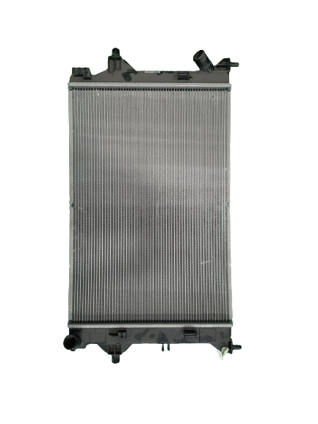
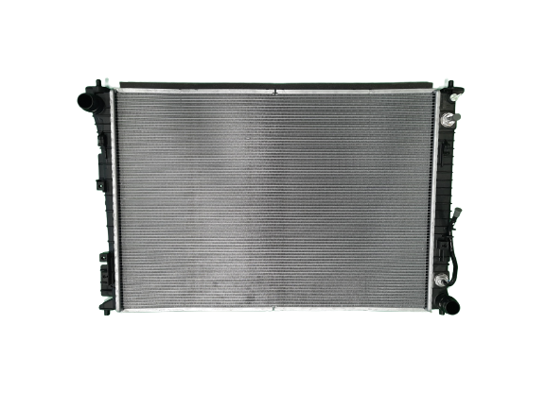
PRODUCTS
THACO TACC
RADIATOR
Radiator
Kia K3/ Cerato
Radiator
Sorento (Gas)
Radiator
Sorento (Diesel)
Condenser of Hyundai ACCENT

