Slide 1


TIK INTERNATIONAL PTE LTD
Your Trusted Partner!

Slide 2

Our Purpose is to provide total trading solution for our client. From beginning of the journey to after-sales support, we create value through professional services.
T
I
K
rust
nsightful
nowledgeable

Slide 3



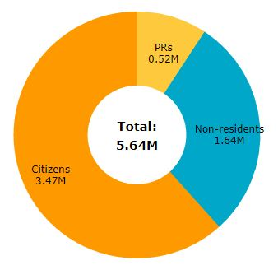
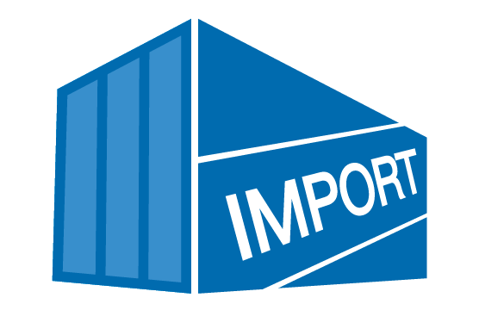

5.64 Mil
In 2018
SGD9,293
In 2018
49KM
15th Largest Importer in World
14th Largest Exporter in World
Household Expenditure

Slide 4



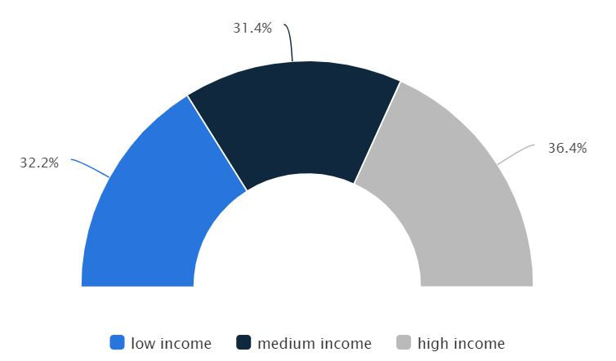
Estimated USD4,906 Mil Revenue
Estimated 4 Mil Online Users
eCommerce Data Singapore

Slide 5
Product Standard requirement
Factory Operating License
Product Ingredient List or Report
Nutrition Report
ISO Certificate (Additional)
Halal Certificate (Recommended)
HACCP
GMP
Lab Test Report
MSDS or Allergy report
Free Sale Certificate

Slide 6
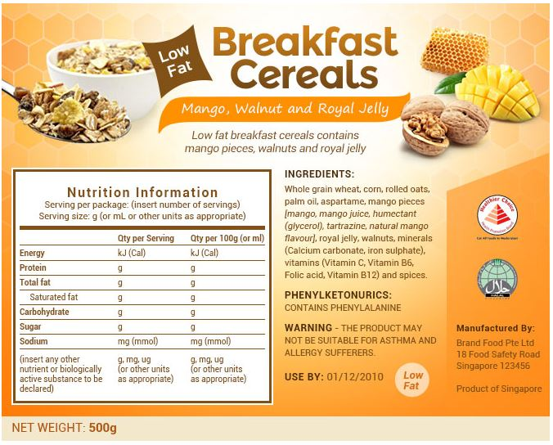

Label requirement (Food)
1
7
7
2
8
9
3
5
6
4

Slide 7
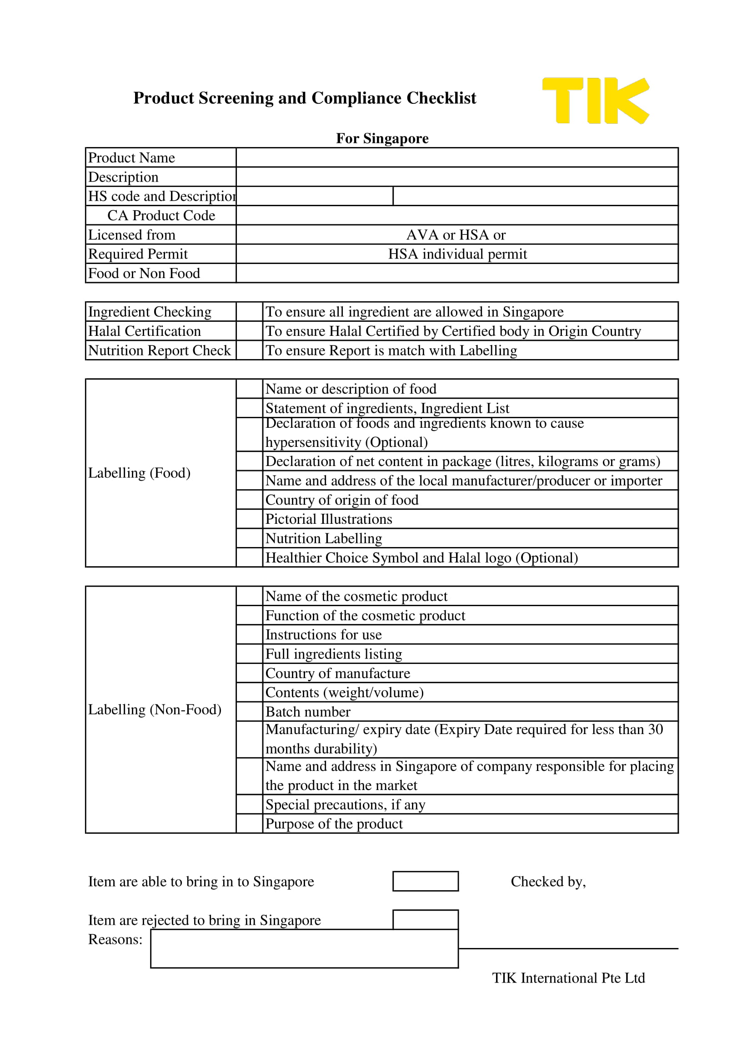
TIK Checklist for Products Import

Slide 8
Before enter Singapore
Information needed and survey
Budget
Target Group
Marketing Strategy
Sales and Channels Entry Target
Current Company Size / Manpower
Current Market Situation

Slide 9
Singapore is a multiracial and multicultural country, with peoples from all over the worlds.
Anything is possible!
Potential Products?
Design
Potential
Product
Taste / Function
Price

Slide 10

Product Chain Cycle
Manufacturer prepare product for export
Product arrive at Singapore Port
Product delivered to customer (online) or offline retail store
Marketing and Promotion for Product
Importer issue PO to Manufacturer
Product cleared from Customs and delivery to Warehouse
Product arrive at Warehouse, destuff and storing
Product distribute to channels (Online and Offline)
Product Handling Services
Logistic Services
Advertisement and Sampling Support
Importation and Licensing Services (IOR)
Outlet Delivery Fulfilment Services
Warehouse Services
Sales Merchandising Services

Slide 11





Importer of Record (IOR)
Sell goods to buyers via website
Export Clearance in the name of shipper or TIK
To Customs
Retailer’s or shipper warehouse in Origin Country
Prepare the shipment & Paperwork
Shipment to Receiving Country
Released from Customs
Import Clearance using TIK as IOR
Last Mile Delivery
Goods delivered to TIK distribution Centre
Delivered to Buyer in Receiving Country
We act as Importer for Customs Clearance; Customer does not need any Company Registration in the country:
We simplify your Trading

Slide 12



International eCommerce Enabler (ICE)
Advantages of the model:
Full control of your branding
Fastest way to establish sales, instead of looking for distributor
Expand network effectively in oversea market
Shorten customer delivery waiting time
Transparent stock report with warehouse management system
Extended scope of services from TIK (In House Custom Declarant)
Import goods via IOR Services
Retailer’s or shipper warehouse in Origin Country
Goods delivered to TIK Warehouse (WMS)
Lazada
Shopee
Amazon
Redmart
Sell goods to buyers via website
Last Mile Delivery
Delivered to Buyer
Malaysia (Coming soon)
Singapore

Slide 13
International eCommerce Enabler (ICE) Process Flow
Shipper send TIK product Information and Certification
Shipment to Receiving Country
To Customs
TIK Check against local requirement
Shipper Prepare Stock in Origin Country
Import goods via IOR Services
Sell goods to buyers via website
List on eCommerce Platform
Released from Customs
Lazada
Shopee
Amazon
Redmart
TIK Prepare Parcel with Label shipment & Document
Goods delivered to TIK Warehouse (WMS)
Parcel Drop Off
Stock Report issued Monthly (WMS)
Payment to Shipper monthly for paid Orders
Returned Good to TIK (If any)
Last Mile Delivery
Delivered to Buyer

Slide 14








eCommerce in Singapore

Slide 15
Company Information
Name : Johnny Ting
Contact Details : +65 9324 5787 (johnny@tikinternational.com)
Company Name : TIK International Pte Ltd
UEN Number : 201838256R
TIK AVA License : IP18K3016
TIK HSA Code : C18020070P
Website :www.tikinternational.com
Address : 14 Robinson Road, #08-01A Singapore 048545

Slide 16
Q&A
Email: johnny@tikinternational.com
WhatsApp: +65 9324 5787

